Slide 1
Milestone 3 Presentation
Jeffrey Fishman, Monier Abdullah, Khalid Saeed, Christian Ene

Slide 2
Team Workload
Team Lead set up a task tracking Kanban board to better divide the workloads
  Sheet was useful and held all of the task info, but was completely overlooked
  Kanban board better tracks who submits what, and can references which changes were submitted overall
Work was more ad-hoc with tasks divided and members to work on them individually, since schedules conflict or are too full
  Members were asked to reach out to one-another if there were any questions about their tasks or something should’ve been developed in parallel with someone else’s task
https://github.com/jifishma/CIS-375-Term-Project/projects/1
Jeff

Slide 3
Team Lead
Still a difficult position
  Directing the group in the correct direction still
    Re-explaining lectures during meetings is extremely inefficient and cannot be sustained
  Ad-hoc work
    The rotating meeting leaders strategy seems to have not worked, and thus having everyone be accountable for their own portions of work after divided seems to have been the next best choice
Jeff

Slide 4
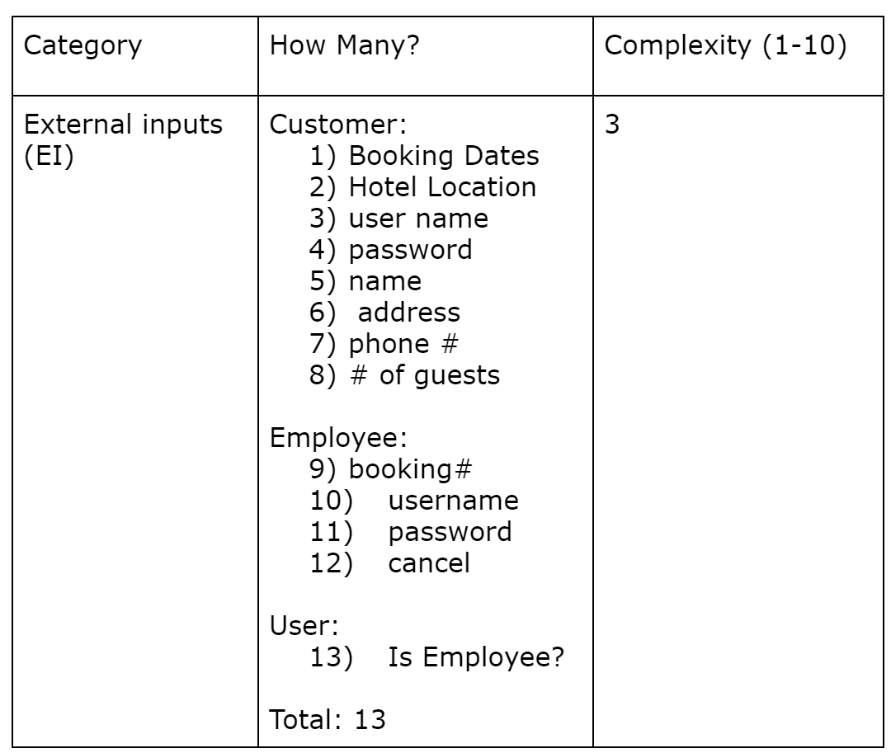
SPMP - Milestone 3 - Function Points
Previous FP estimate for External Inputs:
Jeff

Slide 5
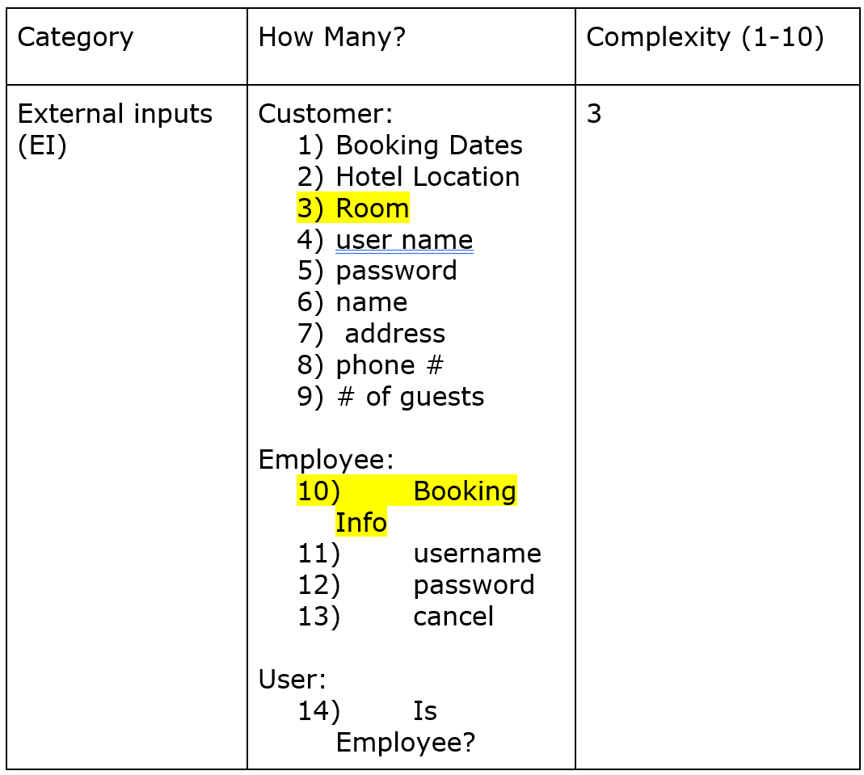
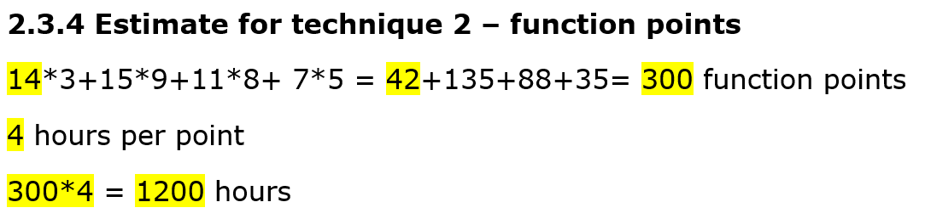
SPMP - Milestone 4 -
Function Points
Function Point | Complexity | Number
External Inputs | 3 | 14
External Outputs | 9 | 15
External Inquires | 8 | 11
Internal Logical Files | 5 | 5
Total FP: 300
4 hours per point
300 * 4 = 1200 hours
Jeff

Slide 6
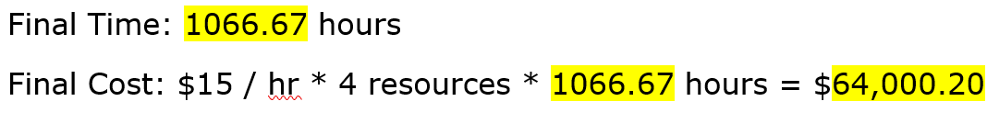
SPMP Milestone 4 - Reconciled Estimate
Jeff

Slide 7
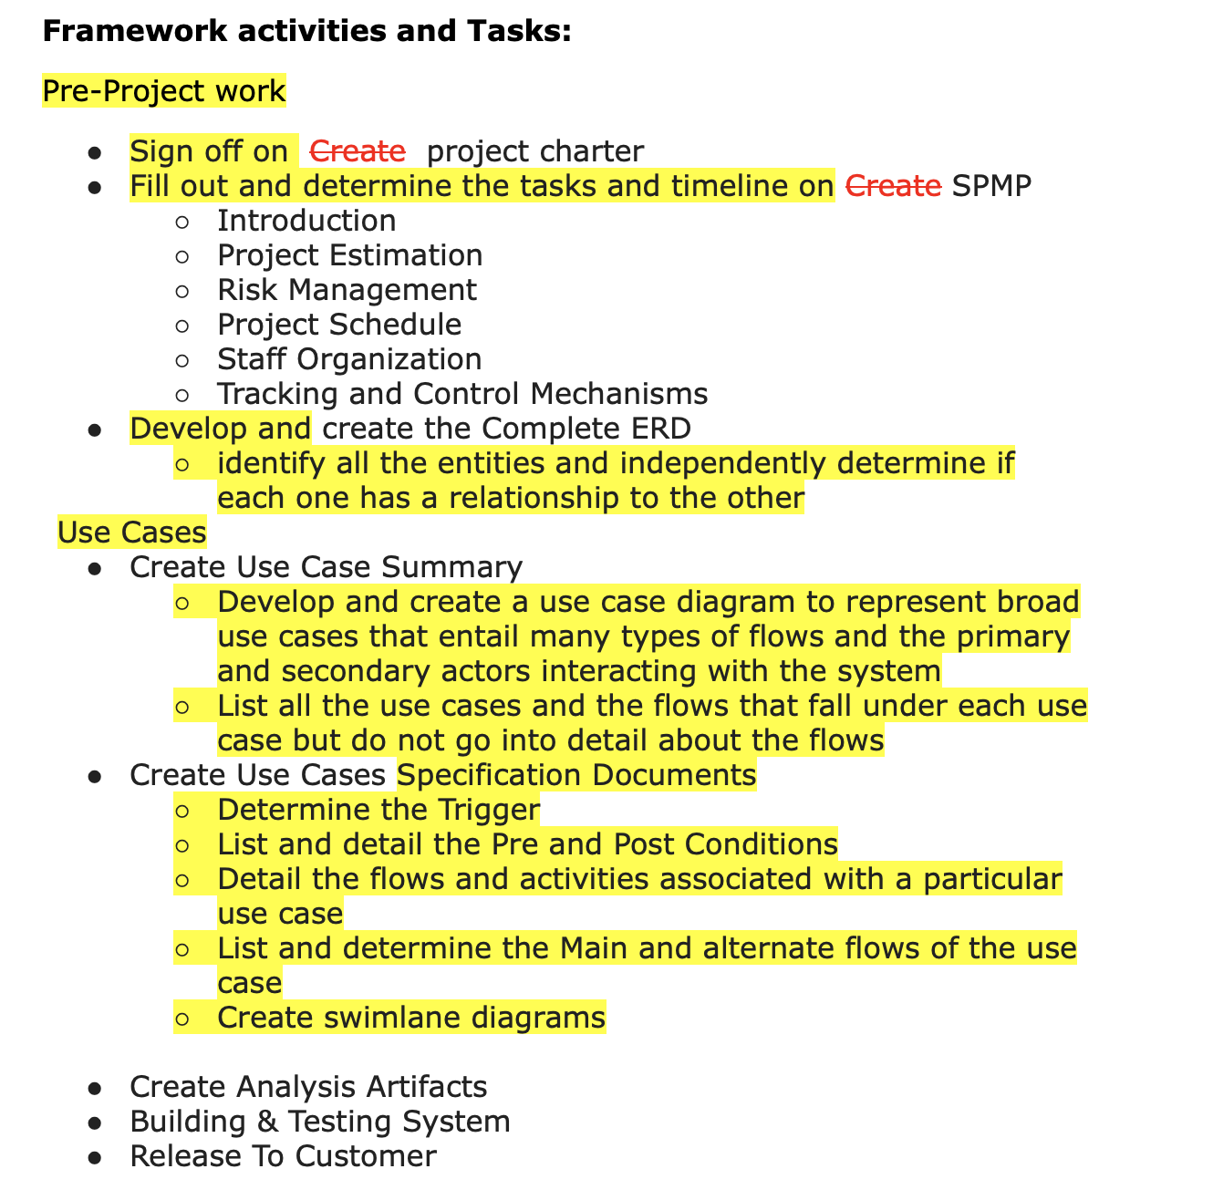
SPMP - Milestone 3 - Tasks
As time progressed, more sub-tasks were identified that needed to be completed
Especially true when it came to developing the use case summary and each of the specification documents
  I.e. creating a diagram, listing each use case, identifying the corresponding flows etc.
Tasks for future milestones will be identified as we get closer to them
Jeff

Slide 8
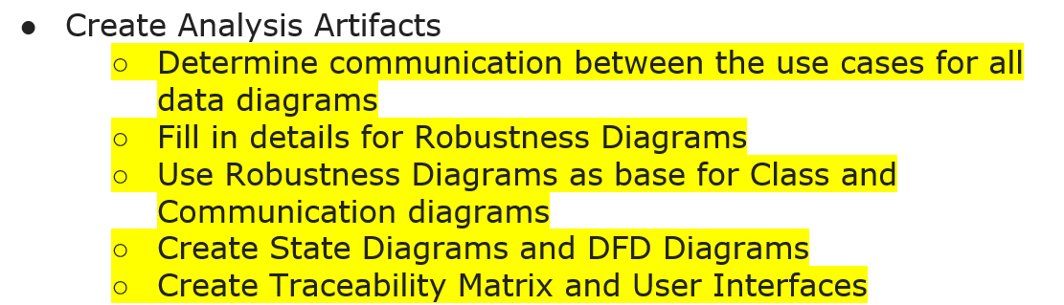
SPMP - Milestone 4 - Tasks
A lot of work was required for milestone 4, and I found that more and more re-work was necessary to get the ERDs accurately reflecting Robustness diagrams and the required entities
As before, tasks for future milestones will be identified as we get closer to them
Jeff

Slide 9
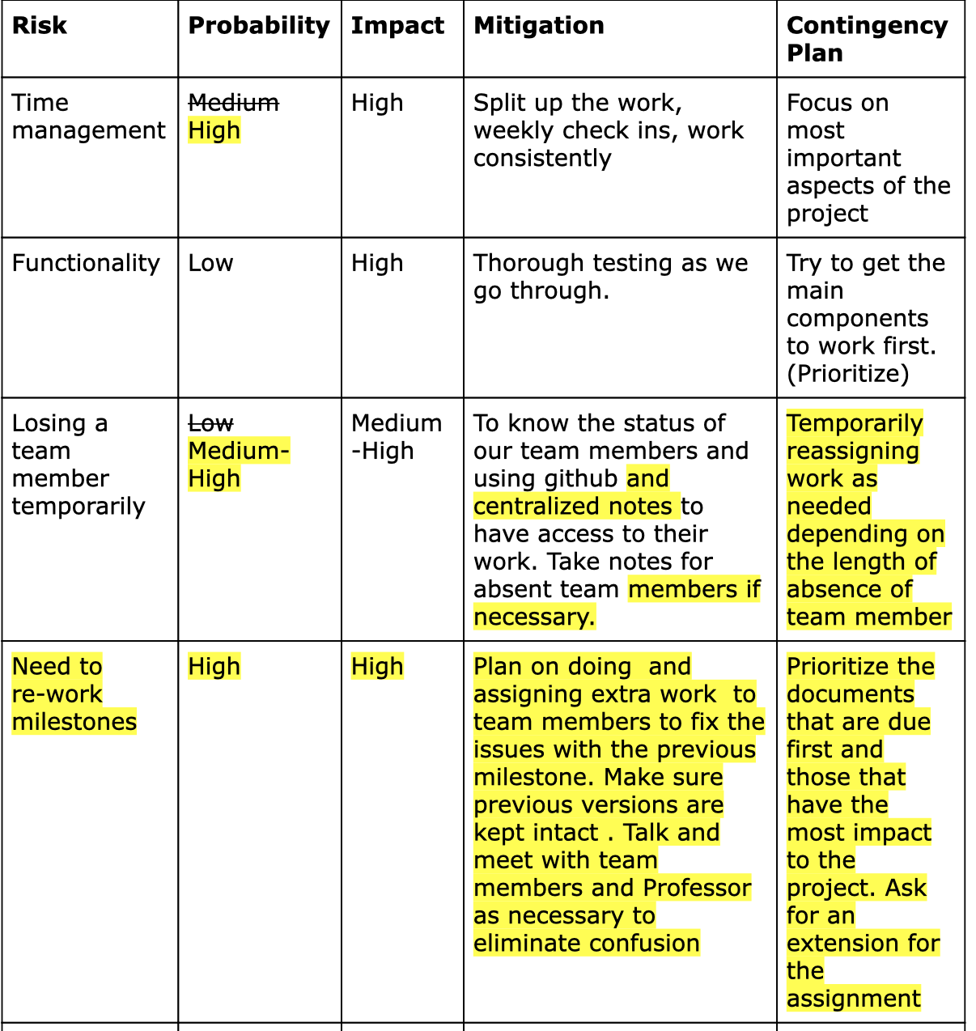
SPMP - Milestone 3 - Risks
Additional risk “Need to re-work milestones” as added after Team lead meeting
  Did not anticipate having to re-work some of the milestones due to them being incorrect
Made modifications to others re-assessing the risk and the mitigation / proactive measure to help lessen the risk
Jeff

Slide 10
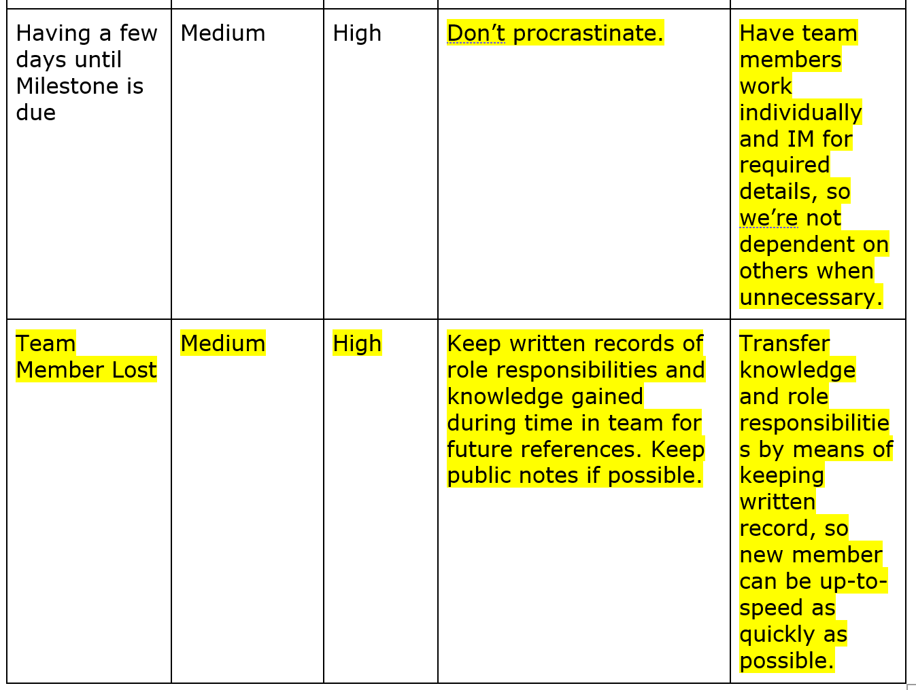
SPMP - Milestone 4 - Risks
Had a change in group members that needed to be accounted for
  Accounted for temporary loss, but not permanent loss, so a new plan was developed and put in place
Filled out details about working in a more timely manner for more sustainable productivity
Jeff

Slide 11
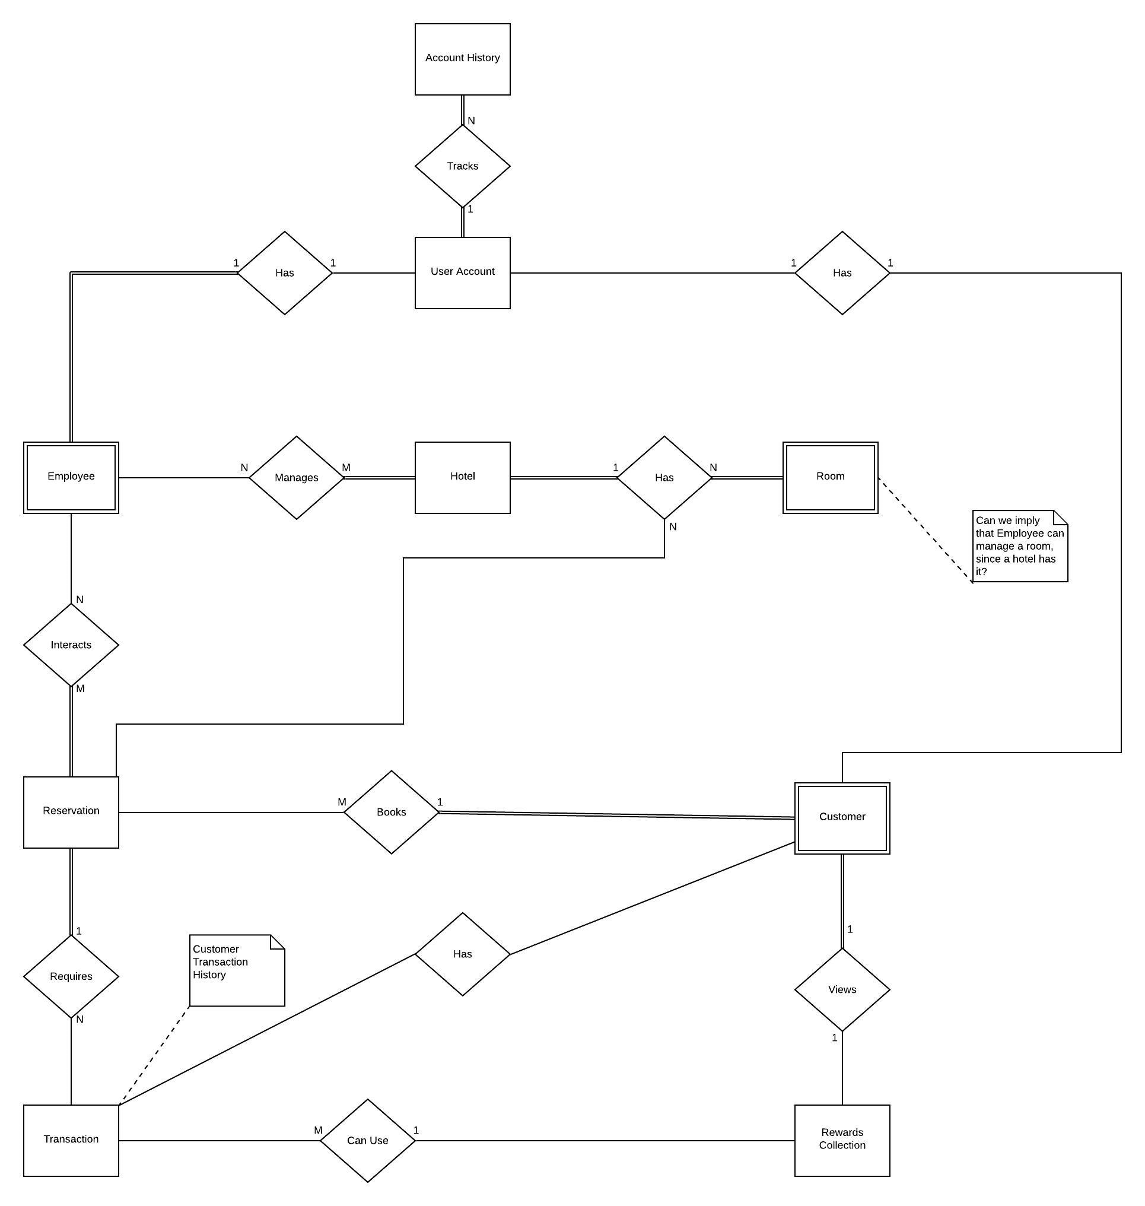
Milestone 4 - Build ERD Updates
Build ERD was updated to have a new entity User Account and Account History
Employee and Customer entities were updated weak entities, connected to the User Account entity
Jeff

Slide 12
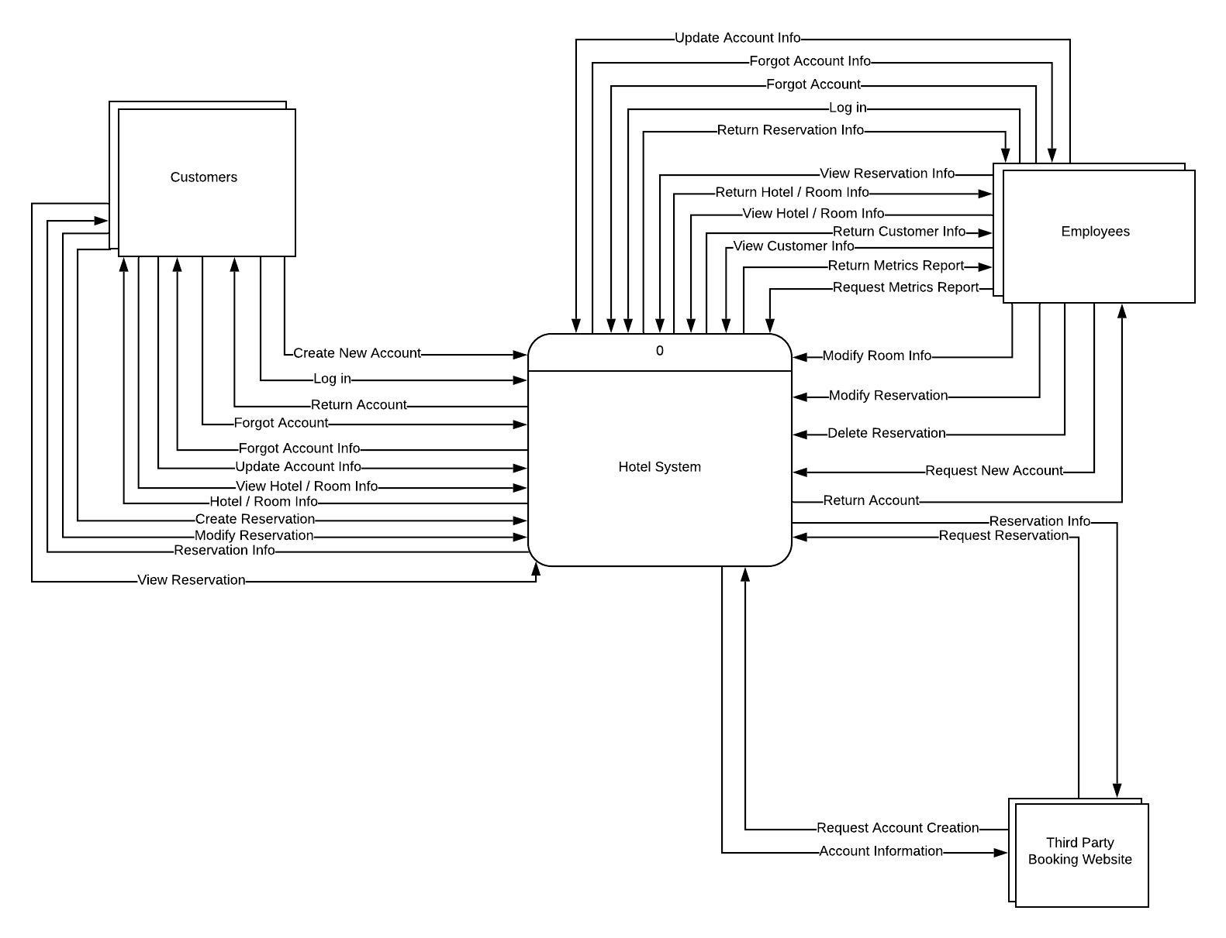
Context DFD
Jeff

Slide 13
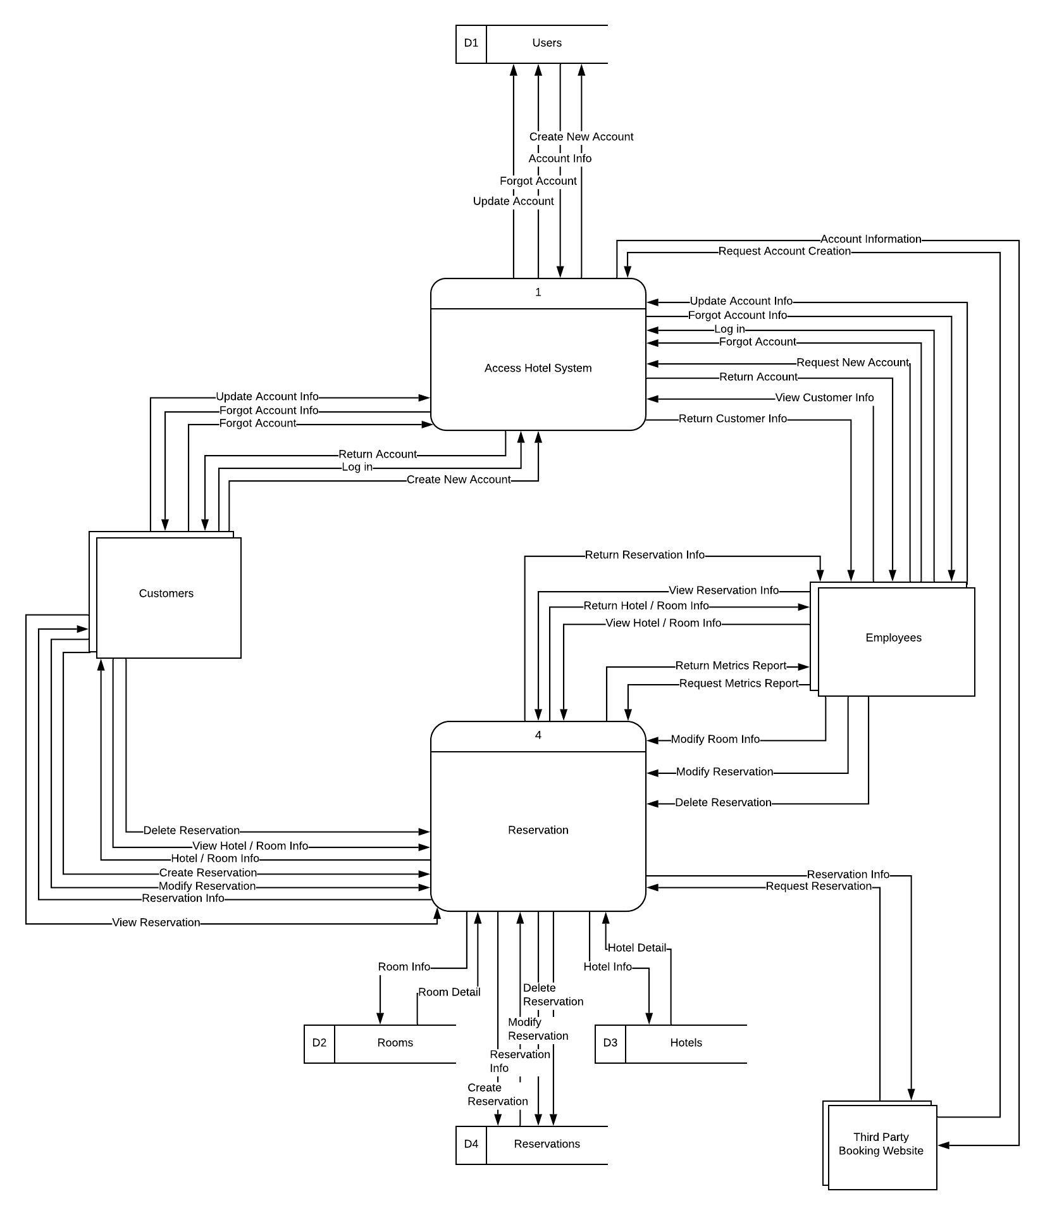
Zero DFD
Jeff

Slide 14
Reservations - Sequence Diagram
Unfortunately N/A

Slide 15
Reservations - Communications Diagrams
View the Reservation Communication Diagrams here
Jeff

Slide 16
Easiest Parts Milestones 1-3
Signing off on the Project Charter
As a team we were ready to jump in to the project, though we didn’t have a good sense of just what was required
Use Case Summary
  Once we had our 2nd version, it was easy to gather information from notes and put them in as flows
Use Case Specification
  We spent a lot of time creating/revising our Use Case Summary, which allowed for use to have good understandings of how each use case will work. It made it easy and clear to create use case specifications for each Use Case.
Jeff

Slide 17
Easiest Parts Milestone 4
Creating a task-tracking board and delegating tasks to team members, as well as a code repository for future use
  I thought this was actually pretty fun setting it up in Git
Jeff

Slide 18
Hardest Parts
Creating the Communication Diagrams
Creating the DFD diagrams were tedious
Jeff

Slide 19
Lessons Learned
Work ahead of schedule!!!
  We had a time crunch when working on Milestone 3 and had to ask for an extension. We tried to plan ahead for Milestone 4, but we didn’t get the results were were looking for. We definitely need to be more mindful of deadlines and effort required to complete tasks before the deadlines
  In our time-tracking document, we still have stretches of days where no work is completed towards our project -- we should be more efficient with spacing out our work evenly and working individually
If we allow buffer time, we can better correct missing or incorrect documents, and ask questions
Jeff

